Slide 1
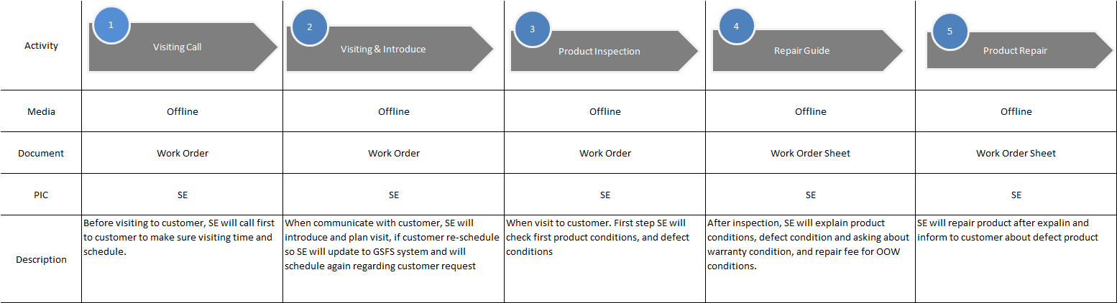
LGEID Process Standard
LGE Internal Use Only
Call Before Visit
Agree to visit?
Repair?
Visiting
Call
Y
Visiting &
Introduce
Product
Inspection
Repair Guide (judging charged or
free repair and notifying result
Y
START
SE, Offline
SE, Offline
SE, Offline
SE, Offline
N
N
Re Appointment
to Customer
N
WO
Filling (*)
Entry Result
/Cancel
END
Adm Svc
SE, Offline
SE, Offline
Entering Incomplete
Repair Result (*)
Product
Repair

